Slide 1
Lecture 8
Communication ports and buses
Computing platforms, semester 2
Novosibirsk State University
D. Irtegov
2019

Slide 2
Topic not covered in tome.pdf
Could not decide, should it be part of Platforms or Computer Network course
In NSU, we decided it to be a part of Platforms course
This is pretty important anyway.
Most digital devices around are communication ports or are accessible only through communication port
Ports have much in common with system and intra-CPU data buses

Slide 3
Examples of digital communication ports
SATA: connects SATA controller to HDD or SSD
DVI/HDMI/DisplayPort
USB (actually a bus, not a port. Difference between bus and port is covered later in this lecture)
Ethernet (also actually a bus, not a port)
WiFi (similar to Ethernet, but uses radio signals instead of wires)
PCI (Peripherial Component Interconnect), used to attach i/o devices to PC-compatible computers
System bus: used to communicate between CPU, main memory and PCI bridge

Slide 4
Parallel and serial ports
Parallel port: transmits N bits per modulation using N data wires
  Advantages: higher speed using given signaling technology
  Disadvantages: more transmitters, receivers and wires than serial port
  Disadvantages: prohibitively expensive when you need long wires
  Disadvantages: cannot be directly converted to analog signal for radio/fiber optic/magnetic recording/modulation suitable for long-distance transmission
  Disadvantages: analog phenomena such as wire crosstalk, bit skew, etc
Serial port: transmits 1 bit per modulation or even less
  Advantages and disadvantages: opposite to parallel ports
  Need serial-to-parallels and parallel-to-serial conversion
  With modern technology it seems that it is cheaper to invest in high signaling speed and use serial ports or buses

Slide 5
Shift registers
Parallel to serial and serial to parallel conversion
Implementing shift instructions in CPU ALU
As part of division, multiplication, cryptographic units
Random number generation
Frequency division
Present in Logisim library

Slide 6
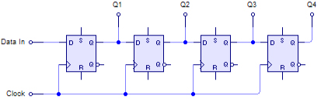
Serial-to-parallel (SIPO) convertor

Slide 7
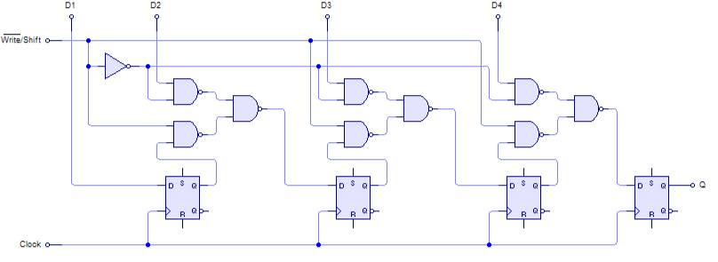
Parallel-to-serial (PISO) convertor

Slide 8

Sequential transmission: line code
Line code is a signaling pattern used to transmit data bits
Transmitter and receiver must use same line code to understand each other
Main problem requiring nontrivial line codes: synchronization
Simplest known line code: NRZ (Non Return to Zero)

Slide 9
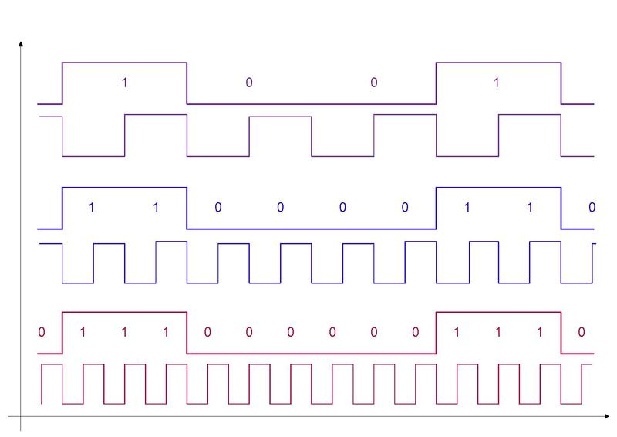
What is wrong with pure NRZ code?
What if clocks of transmitter and receiver do not match?

Slide 10
Solutions for clock matching
Asynchronous ports: transmit data in short bursts (e.q. 8 bits per packet) and hope that clocks do not deviate much during single burst
Strobed ports: use separate wire for clock (strobe)
Synchronous transmission: somehow embed clock in the line code
RLL (Run Length Limited) encoding: change data in such a way, that there will be no long sequences of 1s or 0s

Slide 11
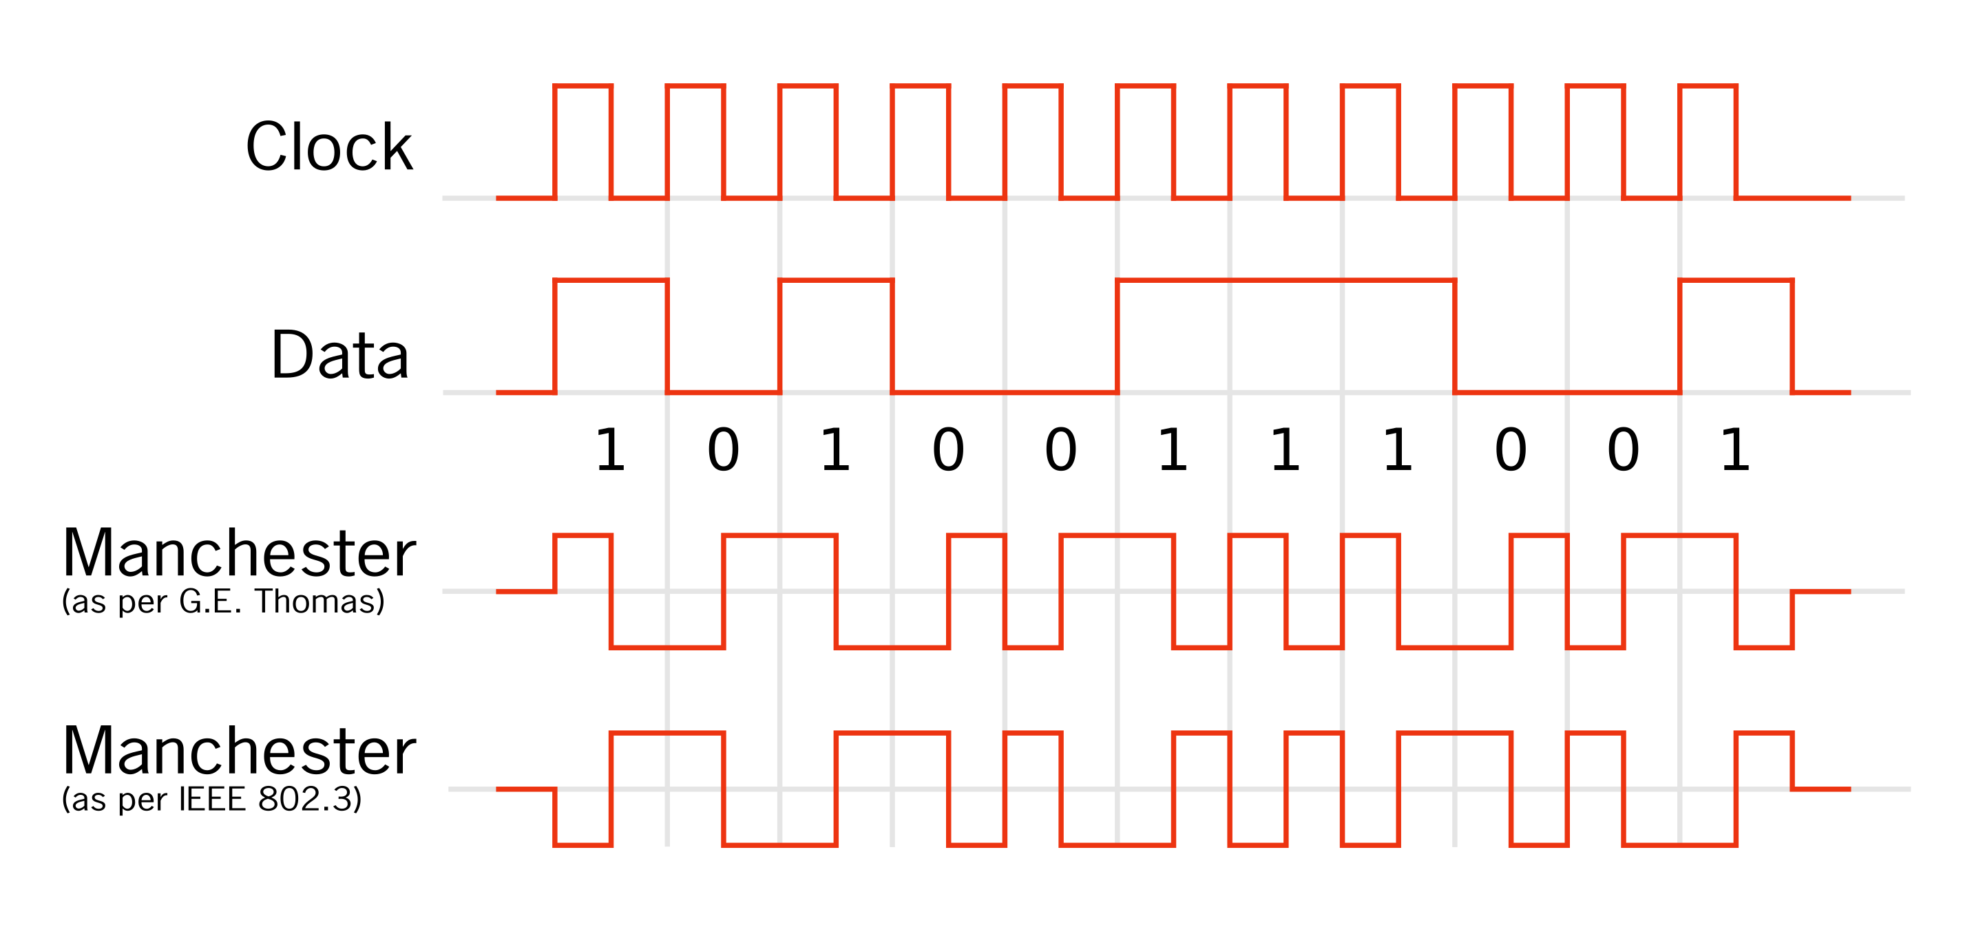
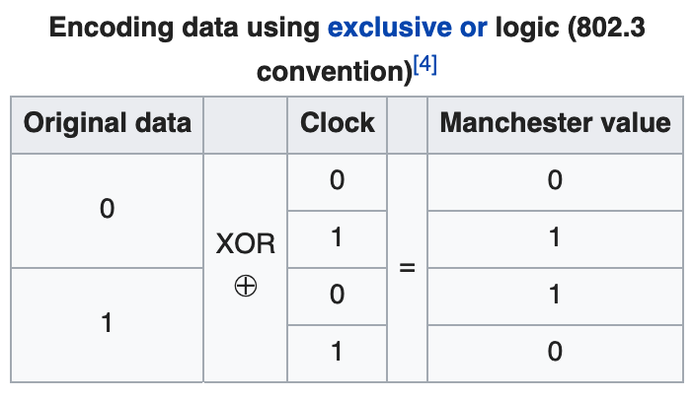
Embed clock in line code
RZ (Return-to-Zero) code
  RLL codes need to limit lengths of 0 runs, but not 1 runs
Manchester encoding

Slide 12
RLL encoding
Bit stuffing: for every 5 consequent 0s embed a single 1
  You have exercise to implement encoding and decoding of this code
Group coded encoding.
  For every data bit pattern of length N build a code pattern of length M
  Code patterns might look totally unrelated to data patterns
  They need to match RLL requirement
  Transmitter and receiver must use common coding table

Slide 13
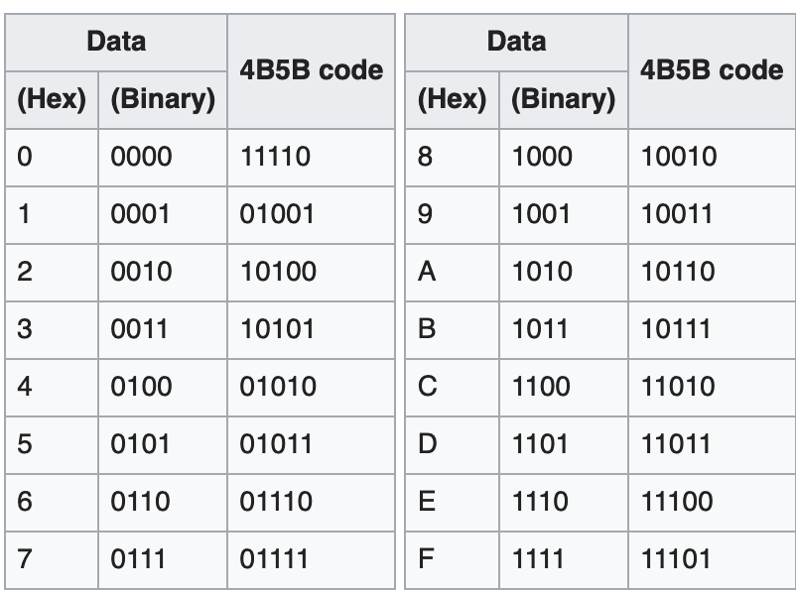
Example of group coding: 4B5B code
Introduced in FDDI
Most commonly used in Fast (100Mbit/s) Ethernet
Has some valid RLL code patterns that do not match any 4-bit data pattern
They are used to mark packet starts and ends and for other purposes

Slide 14
Checksums and error correcting codes
Physical data transmission often happens with errors (thermal noise, EM interference, bad contacts)
Simple checksums help to detect errors:
  Parity bit (XOR of all data bits)
  CRC (you have exercise for this)
More complex redundancy schemes allow to recover damaged bits:
  Huffman code
  Reed-Solomon codes
  You will study them later in advanced chapters of discrete math

Slide 15
Bus (multipoint port)
Bus by definition requires addressing: who talks to whom
  Parallel buses sometimes have separate lines for address and for data
  But even many parallel buses have multiplexed address and data
  Serial buses usually use same wires for address and data
Some buses have single master (only one device can initiate talks)
  Examples: USB, system bus with single CPU
Even single-master bus require nontrivial talk protocols
  Reading the memory involves master (CPU) sending a request and the address, and slave (memory) sending the data

Slide 16
Multimaster buses
Most modern buses allow multimastering: several devices or even all devices can initiate talks
Multimastering assumes arbitration: resolution of conflicts when several masters initiate talk on overlapping time interval
In modern computers, not only CPUs can be the master on a system bus
  I/O devices can directly talk to memory, so called DMA (Direct Memory Access)

Slide 17
Physical bus topologies
Physical bus: single [bunch of] wires
or other transmission media (e.q. radio)
  Probably simplest to understand
  Only one talk can happen at any given time
  Examples: CdM-8 system bus, many old mini- and microcomputer buses
Star-like topology with central [analog] repeater (hub)
Ring topology
  Several talks can happen at once
  Natural arbitration: there is a marker circulating in the ring, and device can transmit only when it has a free marker
  Failure of any device leads to failure of entire ring

Slide 18
Bridges and switches
Bridge is a two port tranciever connecting two buses
Bridge can connect buses with different protocols and signaling speeds (different speeds usually require buffering)
  Connecting system bus to PCI or 100Mb/s Ethernet to 1Gb/s Ethernet
Bridge must know addresses of devices on both buses
  Actually, it must know only addresses of the devices that are allowed to talk to devices on other bus
  Bridge also can do address translation and connect buses with differing addressing schemes (e.q. PCI to USB).
  Many real bridges use learning algorithms to build address table
  Most known learning algorithm: SAT (source address table)
  Size of bridge address table limits the size of bridged network
Higher-level routing protocols are needed to build really big networks, like Internet

Slide 19
Switches
Generally speaking, switch is just a multiport bridge
Many modern bus protocols require switches as connecting devices
  USB 2.x and 3.x, PCI Express, Ethernet
Real switches try to interconnect as many concurrent talks as possible
  Matrix switches
  Multilevel matrix switches
  Switching fabrics
  Interesting but far beyond scope of our course
Bus using switches often remains a logical bus: every master device can talk to any other device

Slide 20
Real bus protocols
Features present in many modern bus protocols:
  Protocol negotiation (signaling speed, line code, arbitration scheme, packet format dialects)
  Authentication and encryption (especially important for radio networks)
  Autoconfiguration: device reporting to the master its type, capabilities and resource requirements (so operating system can find suitable driver for the device)
  Autoconfiguration: automated address assignment
  Most buses transmit data in big bunches, or packets.

